Slide 1
Developing An Effective Enterprise Solution Powered By SOA
Service Oriented Architecture (SOA) & Web Services
Strategies for Governing the Implementation of SOA, Increasing Business Agility and Reducing IT Integration Costs
October 16 - 18, 2006, Intercontinental Buckhead, Atlanta, GA
Dr. Brand Niemann, Enterprise Architecture Team, US EPA,
and Co-Chair, Federal SOA Community of Practice
October 18, 2006, 2 p.m.

Slide 2
Description
Understand how the Federal SOA Community of Practice (CoP) is organized around four tasks:
  Reference Models
  SOA Governance
  SOA Implementation and Testing
  SOA Connections to the Federal Enterprise Architecture’s Service Components Reference Model.
Learn how SOA innovations fostered by the SOA CoP include a systematized approach to implementation and semantic SOAs.

Slide 3
Speakers Bio
US EPA Office of the Chief Information Officer and Environmental Information, Enterprise Architecture Team:
  EPA Data Architecture for DRM 2.0
Federal Chief Information Officer Council, Federal Enterprise Architecture’s Data Reference Model 2.0:
  Lead for Implementation Through Testing & Iteration
Federal CIO Council’s Two Committees:
  Co-Chair, SOA Community of Practice
    First SOA for E-Government Conference, May 23-24, 2006
    Second SOA for E-Government Conference, October 30-31, 2006
  Co-Chair, SICoP
    Semantic Interoperability Community of Practice
      World Wide Web Consortium’s Semantic Web Standards and Semantic Agents
    5th Semantic Interoperability for E-Government Conference, October 10-11, 2006

Slide 4
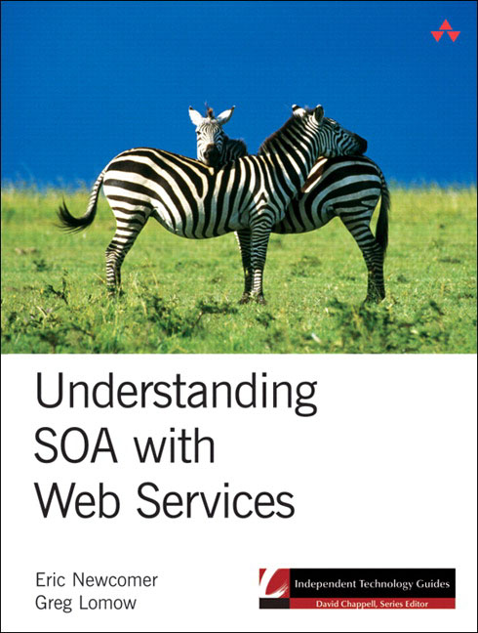
Co-Chair- Greg Lomow
10+ years experience designing and implementing SOA Solutions
  Public Services, Financial Services
  & Commercial Services
Co-Author “Understanding SOA
with Web services”, Addison-Wesley,
2005
Co-Chair, SOA Community of Practice
  First SOA for E-Government Conference
  May 23-24, 2006
  Second SOA for E-Government Conference
  October 30-31, 2006
BearingPoint, Inc
  System Architect & PS SOA Solution Lead

Slide 5
What Attendees Will Learn
1. The impact of Service-Oriented Architecture (SOA) on federal EA programs.
2. How architects can ensure widespread SOA adoption within their agency.
3. The current state of SOA across federal government.
4. How to establish a SOA vision and follow a practice methodology.
5. How to cope with confusing buzzwords, conflicting techniques, overlapping technologies, and other aspects of the SOA landscape.
6. Best practices for SOA initiatives assessment and measurement of SOA maturity.
7. How to achieve a workable balance between the FEA and SOA.
http://events.fcw.com/events/2006/ea/downloads/EA06_3-4_Niemann.pdf

Slide 6
Roadmap
1. Slides 7-8.
2. Slides 9-19.
3. Slides 20-23.
4. Slide 21 & 29 - Everware – CBDI Tutorial.
5. Slide 24 and 25 – Read the Book.
6. Slide 26 & 27 – Panel Session and IAC SOA Committee Survey.
7. Slide 27-31 – Join the SOA CoP and participate in the 2nd Conference and Demo!
  Register for October 30-31st at http://www.mitre.org/register/soa/

Slide 7
Abstract
Enterprise architecture in the Federal Government is evolving into two camps, namely, the Federal Enterprise Architecture (FEA) and Service-Oriented Architecture (SOA). The FEA focuses on the OMB budget process and project management while SOA is the actual modeling of complex IT and governance environments like GSA is doing for the Financial Management Line of Business (LoB). Both are needed and can be complimentary - which is what this conference session will show about achieving a wise balance between the two in support of the Lines of Business (LoB) and the new Federal Transition Framework (FTF).

Slide 8
Abstract
The SOA CoP, a joint project of the Governance and Services Subcommittees of the Architecture & Infrastructure Committee and of the Semantic Interoperability CoP of the Best Practices Committee, is working to bridge these two camps by using a community of practice approach to develop a SOA Interoperability Demonstration Protocol (SIP) and an IAC-sponsored survey of the IT community on the culture, education, and technology aspects of SOA.
This presentation will report on the First SOA for E-Government Conference, May 23-24th, the SIP, and the IAC-sponsored survey. It will also report on plans for the 2nd SOA for E-Government Conference, October 30-31st, where more SOA interoperability demonstrations between vendors are in progress.

Slide 9
Federal Organizations
The Federal CIO Council has three Committees:
  Architecture & Infrastructure (AIC), Best Practices (BPC), & IT Workforce (ITWF).
    The AIC has four Sub-committees (see next slide) that support the OMB Federal Enterprise Architecture (FEA) Program Office led by Chief Architect, Richard Burk.
    The AIC & BPC have done joint events & collaborations (see slide 14) that have focused on EA governance issues.

Slide 10
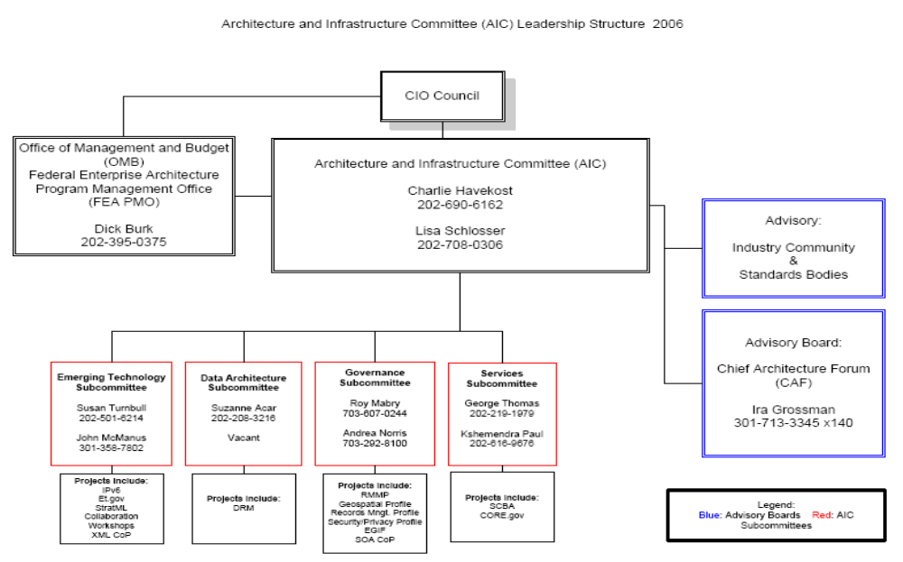
Federal Organizations
SOA CoP

Slide 11
Federal Organizations
Brief History:
  1. AIC Governance Subcommittee (Roy Mabry, Co-Chair) requests SICoP (Brand Niemann) form a SOA CoP and do a conference as a project (January 2006). SICoP has a history of doing projects for the AIC (e.g. DRM 2.0).
  2. SICoP agrees and has support from the AIC Emerging Technology Subcommittee (Susan Turnbull).
  3. SICoP proposes the entire AIC adopt the SOA CoP, especially the two new Subcommittees on Data Architecture and Services.
  4. First SOA for E-Government Conference is held at MITRE, May 23-24, 2006.
  5. IA SOA Committee praises the SOA CoP and the First Conference and suggests it continue. The vendor community continues to support the SOA CoP Demo.

Slide 12
Federal Organizations
Brief History (continued):
  6. SICoP offers to share the government leadership of the SOA CoP with the AIC Services Committee Co-Chair George Thomas, who publicly requests help to carry outs the SC’s work.
  7. Both the Data Architecture and Services Subcommittees announced they are "doing SOA" at the September 19th AIC meeting (so effectively all four Subcommittees are doing SOA!).
  8. Dick Burk, FEA Chief Architect, describes SOA as an EA strategy (see next slide), and Lisa Schlosser, AIC Co-Chair, describes how HUD and the AIC are focusing on SOA, at the 2006 Federal IT Summit, October 4th.
  9. The AIC’s Chief Architect Forum begins to feature presentations on SOA and the IAC EA SIG begins work on a “SOA for Managers” White Paper.
  10. The SOA Cop Demo focuses on the FEA’s Financial Management & Human Resources Lines of Business and has increased vendor participation for the 2nd SOA for E-Government Conference, October 30-31st.

Slide 13
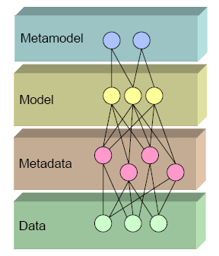
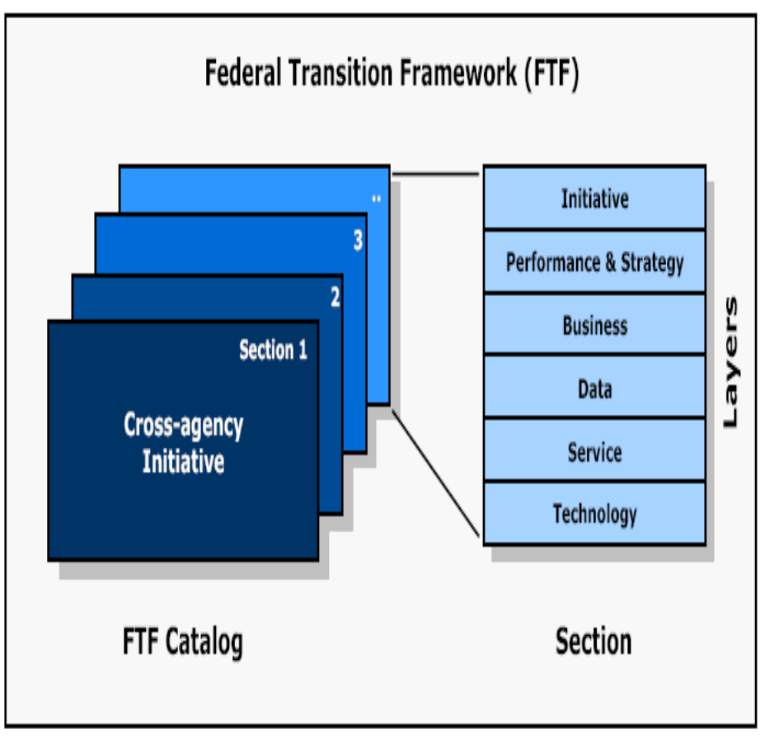
Metamodels
This “publish catalog” could lead to…
This metamodel for DRM 2.0 could…
the “publish”, “find”, & “bind” of a SOA.
become services layers in a SOA.

Slide 14
Federal Organizations
January 24, 2006, Workshop on Bootstrapping Service-Oriented Architecture and Semantic Interoperability Toward Transformative Practice Featuring:
  SOA for E-Gov Initiatives Like E-Grants at the Federal and State Level and Federal Health Architecture Data Architecture.
  SOA Governance (see next slide).
  SOA Best Practices.
See http://colab.cim3.net/cgi-bin/wiki.pl?ExpeditionWorkshop/AdvancingCredibleCommitments_AgileSensing_BootstrappingServiceOrientedArchitecture_2006_01_24

Slide 15
Federal Organizations
Highlights of SOA Governance Issues:
  Difficulty understanding the relationship between the FEA and SOA (*slides 9-15).
  The need to understand the software design principle of “abstraction and indirection” and its application to SOA to know when to apply SOA (*slides 19-26).
  The need for some best practices of SOA, Composite Applications, Semantic SOA, and their platforms (*slide 44).
  The need for some best practices of SOA Governance approaches (slides 45-46) (*slides 11-12).
  Comments at Chief Architects Forum, January 26, 2006 (*slides 55-56).
* See http://web-services.gov/scopesoa01242006.ppt

Slide 16
SOA Governance Approaches
Opportunistic – Make every new application and system modernization a state-of-the-art Web Service.
  EPA’s Award Winning Web Services.
    Kim Nelson: “I wish we had created more Web Services than data warehouses.”
Mandated from on high – The Joint Chiefs of Staff said we will have a medical readiness information system to go to war in Iraq.
  Medical Operational Data System (MODIS).
    Incremental bootstrapping approach. July 22, 2003, see http://www.mods.army.mil/

Slide 17
SOA Governance Approaches
Specified in Collaborative Software Component Development and Reuse:
  Dr. Jeffrey Poulin, “Measuring Software Reuse: Principles, Practices, and Economic Models”, Addison-Wesley, May 14, 2004, Workshop (next slide).
Fostered in Communities of Interest:
  DoD CoI Forum: Propose pilot to expose and share data with Web Services, get sign-off by 1-2 star general, complete the pilot, and expose to acquisition (January 19, 2006, meeting).
Visionary Agencies and Organizations:
  NSA Semantic SOA - Participation in standards organizations and piloting of state-of-the art emerging technologies.

Slide 18
Some Earlier Resources
Emerging Technology Innovations in Software Components Development, Reuse, and Management – Applications to Government Enterprise Architecture, May 14, 2004:
  See http://colab.cim3.net/cgi-bin/wiki.pl?ExpeditionWorkshop/SoftwareComponentsWorkshop_2004_05_11
Suggested Roadmap from the FEA to SOA/SIA, Management of Change Conference, May 25, 2005:
  See http://web-services.gov/scopemoc05252005.ppt
High Performance Government: SOA Led Organization Transformation – Racing Towards Business Improvement, SOA Executive Event, May 12, 2005:
  See http://web-services.gov/scopesoa05122005.ppt

Slide 19
Some Recent Events
September 11-13, 2006, 6th Enterprise Architecture Conference & Exhibition:
  Track 3: Implementation Strategies, Results, and Experience:
    September 12, 2006, 10:15AM - 11:30PM, Session 3-4: Best Practices for Driving SOA Adoption With EA Programs
      What Attendees Will Learn (recall slide 5).
September 13th, Special Meeting of the Best Practices Committee - 1-2:30 p.m. (free):
  Theme: Networking EA and the BPC’s CoPs*
    Atrium Ballroom B, Reagan International Trade Center (Federal Triangle Metro Station).
* See slides 5-6 for six reasons why at http://colab.cim3.net/file/work/BPC/2006-07-26/BPC07262006.ppt

Slide 20
SOA for E-Government Conference, May 23-24th, 2006
Opening and Closing Keynotes:
  Ron Schmelzer, Founder of ZapThink.
  Richard Soley, CEO, OMG.
SOA CoP Demo:
  Cory Casanave, CEO/President, Data Access Technologies, Inc.
  Current Commercial Participants: Sun, Booz Allen Hamilton, Starbourne Communications Design, and Oracle
Panel Session - Embracing the right people, questions, and policies for success with SOA in the Federal enterprise and the SOA Survey, Industry Advisory Committee SOA Committee.
Networking Lunch and Exhibits/Demos (30)
Special Recognitions (9)
Breakout Session (12):
  Security within SOA, SOA Technologies, and SOA Pilots and Implementations.

Slide 21
SOA for E-Government Conference, May 23-24th, 2006
Four Tracks:
  Track 1: SOA Reference Models, Specifications, and Standards, Rebekah Metz, Booz Allen Hamilton
  Track 2: SOA Governance, Eric Marks, President/CEO, AgilePath
  Track 3: SOA Implementation and Testing, Cory Casanave, CEO/President, Data Access Technologies, Inc.
  Track 4: Connections to the FEA Service Components Reference Model, George Thomas, Chief Architect, GSA
Two Half-day Tutorials:
  Everware - CBDI, David Sprott and David Mayo.
  Model Driven Architecture and Semantic Web Services: A Case Study, Elisa Kendall.

Slide 22
Special Recognitions
Sophia Brock, MITRE: For “Outstanding Service” to the First SOA for E-Government Conference.
Roy Mabry, Co-Chair AIC Governance Subcommittee: For "Fostering" the SOA Community of Practice and the First SOA for E-Government Conference.
Ron Schmelzer, ZapThink: For "Outstanding Leadership" to SOA as Founder of ZapThink and Co-Author of “Service Orient or Be Doomed!: How Service Orientation Will Change Your Business”.
Cory Casanave, CEO/President, Data Access Technologies, Inc.: For "Outstanding Leadership" of the SOA Community of Practice SOA Demonstration and Specification for the First SOA for E-Government Conference.

Slide 23
Special Recognitions
IAC SOA Committee - Greg Hauser, Chair, Sid Chowdhary, Co-Chair, Gerry Anderson, Programs Chair, Bob Brogan, Software Focus Group Manager, Jana Jackson, SOA Benefits & Cultural Change Focus Group Manager, John Smith, CTO, and William Sweet, SOA Technology Solutions Focus Group Manager: For the "SOA Readiness Panel and IAC SOA Survey" at the First SOA for E-Government Conference.
Forum Systems — Web Services & SOA Security and Parasoft’s SOATest — Testing Service-Oriented Architectures: For “Best Exhibit”.
Anthony Bradley, Booz Allen Hamilton, Bringing SOA to Life: The DCGS-A interface Specification Drive: For “Best Presentation" in the Main Session
Sukumar Dwarkanath, COMCARE, and Michael Daconta, Oberon Associates, Emergency Services Enterprise Framework: A Service-Oriented Approach: For “Best Presentation" in the Breakout Session.

Slide 24
SOA Readiness Test
1. Service Orientation is:
  a. A business concept
  b. A technology concept
  c. A software development concept
  d. A McDonald’s concept
10. SOA is:
  a. Service-Oriented Architecture
  b. Leveraging business resources as Services
  c. An Enterprise Architecture Pattern
  d. All of the above
SOA for E-Government Conference, May 23-24, 2006, Based on Service Orient of Be Doomed! How Service Orientation Will Change Your Business, by Jason Bloomberg & Ronald Schmelzer, Wiley, March 2006, 272 pages.

Slide 25
More SOA Readiness Test
7. The “secret of the best ice skaters” is to:
  a. Not fall
  b. Do as many quads as possible
  c. Wear a fancy costume
  d. Make it look easy
13. Your SOA pilot should:
  a. Build acceptance for SOA within the organization
  b. Evaluate various commercial products that purport to help with SOA rollout
  c. Educate the technical team on the intricacies of SOA
  d. Work on the more challenging aspects of its constituent Services
  e. All of the above
SOA for E-Government Conference, May 23-24, 2006, Based on Service Orient of Be Doomed! How Service Orientation Will Change Your Business, by Jason Bloomberg & Ronald Schmelzer, Wiley, March 2006, 272 pages.

Slide 26
IAC SOA Committee
Organization:
  Chair: Greg Hauser, Webworld Technologies
  Administrative Officer: Debbie Brown, Sun Microsystems
  Education Group, Bob Brogan, BEA
  Cultural Group, Pat Heinig, PPC
  Technical Group, John Smith, Ventera
Roles in 2nd SOA for E-Government Conference:
  Panelist and Exhibitor - Final SOA Survey released.
  Chair Breakout Session and Judge Best Presentation.

Slide 27
SOA for E-Government Conference, October 30-31st, 2006
Opening and Closing Keynotes:
  Ron Schmelzer, Founder of ZapThink.
  David Linthicum, BRIDGEWERX (see next slide)
SOA CoP Demo:
  Cory Casanave, CEO/President, Data Access Technologies, Inc. and Commercial Participants
Panel Session:
  Organizers: Ron Schmelzer, Cory Casanave, and Greg Hauser (Chair, IAC SOA Committee)
  Topic: SOA Lessons Learned: The Government Speaks
Networking Lunch and Exhibits/Demos (30 maximum)
Special Recognitions
Breakout Session (12):
  (1) Panel on Vendor Perceptions and Implementations, (2) Governance, (3) Transition to SOA in the Government, and (4) What Are the Benefits?

Slide 28
SOA for E-Government Conference, October 30-31st, 2006
David Linthicum, President and CEO, BRIDGEWERX, Author, and SOA Thought Leader:
  Steps to Success with Service-Oriented Architecture
    http://events.fcw.com/events/2006/ea/downloads/EA06_3-5_Linthicum.pdf
  "US Government...SOA to the Rescue?", "I do think some of the more spectacular SOA successes will come from the government side.“
    See http://weblog.infoworld.com/realworldsoa/archives/2006/09/us_governmentso.html

Slide 29
SOA for E-Government Conference, October 30-31st, 2006
Four Tracks:
  Track 1: Real World SOA Experiences/Lessons Learned Being Organized by Ali Arsanjani, IBM, and Marc Halley, MITRE
  Track 2: SOA for Information Sharing Being Organized by Greg Lomow, BearingPoint
  Track 3: SOA and BPM, MDA, etc. Being Organized by Cory Casanave, Data Access Technologies, Inc.
  Track 4: SOA and Metadata (Ontology) Being Organized by Chuck Mosher, MetaMatrix
Two Half-day Tutorials:
  Migration of Legacy Components to an SOA, Dennis Smith, Carnegie Mellon
  Approaches for Modeling SOAs within Existing Architecture Tools and Reference Models, Michael Allford and Kevin Brett, SRA International

Slide 30
SOA CoP Demo
SOA for the Federal Enterprise - Across the Lines of Business (LoB).
SOA for Project Management – Across the Human Resource and Financial Management LoBs.
  Try to make executable across multiple vendors for October 30-31st.
  Try to address the new OASIS SOA-RM V1.0. and the new Federal Funding Accountability and Transparency Act of 2006 - S.2590 using XBRL.
  Try to provide input to the new IAC EA SIG White Paper on “SOA for Managers”.
    October 18-19th: Everware – CBDI Forum Summit: Practical Repeatable SOA, Washington, DC.
Also present at the December 4th, OMG SOA Days in Washington, DC.

Slide 31
SOA CoP Demo
Demo Wiki page:
  http://colab.cim3.net/cgi-bin/wiki.pl?SoaLobDemo
October 3, 2006, Meeting:
  http://colab.cim3.net/cgi-bin/wiki.pl?DemoMeeting100306
  http://www.modeldriven.org/soademo/SOALobDemoMeeting2b.ppt
Evolving specification:
  http://colab.cim3.net/cgi-bin/wiki.pl?SoaLobDemoSpec

Slide 32
Semantic SOA
Semantic Service Oriented Architecture (SSOA):
  SICoP:
    Public Meeting (September 14, 2005): Semantic Interoperability Architecture Pilots, Rex Brooks and Team (Event Ontology)
    4th SIEGOV Conference: Best Co-Papers: Elisa Kendall, Sandpiper, Sam Chance, US Navy, and Michael Seebold, Concurrent Technologies Corporation (recall slide 17)
      Enables dynamic discovery of new services as they become available and provides resources for enabling semantic descriptions of those services.
    5th SIEGOV Conference: Arun Majumdar, Cutter Consortium, Operationalizing SOA: Lessons Learned.
  SOA CoP:
    2nd Conference: Track 4: SOA and Metadata (Ontology) Being Organized by Chuck Mosher, MetaMatrix (recall slide 29)
      At the 4th SIEGOV Conference: Special Recognition for Best Semantic Harmonization Tool Application to Chuck Mosher, MetaMatrix

